Slide 1

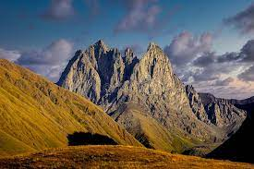
Attachment theory and sense of place for visitors to Kazbegi National Park
Authors
António Cardoso (Fernando Pessoa University)
Manuel Sousa Pereira (Polytechnic Institute of Viana do Castelo)
Bruno Barbosa Sousa (Polytechnic Institute of Cávado and Ave)
Tamari Poladashvili (Fernando Pessoa University)
Silvia Faria (Portucalense University)

Slide 2
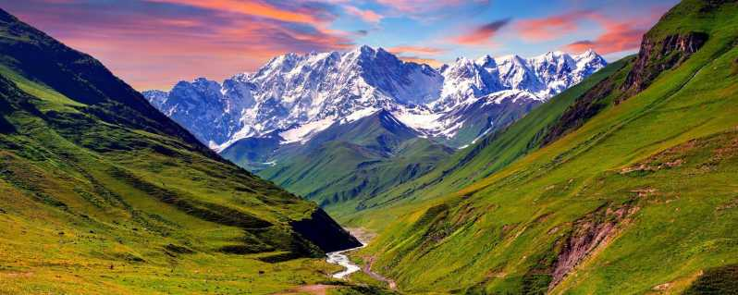
Introduction
Literature review
Methodology
Results analysis
Conclusions

Slide 3
Introdution
This study seeks to empirically contribute to the analysis and interpretation of issues related to “sense of place” in terms of environment and tourism, particularly in national parks. In this sense, a conceptual model was developed that identifies the explanatory factors of the “sense of place”, such as: “place identity”, “place dependence”.
The empirical work resorted to the quantitative method to obtain the data that portray the Kazbegi National Park case study. The questionnaire was carried out with the aim of relating the experience of tourists with the place, the feeling of place, their activities, their attitudes towards the development of current conditions of tourism and future improvements.
The results show that tourists who visit Kazbegi National Park have significant levels of “place attachment”, “place identity”, “place dependence” and satisfaction with the place.

Slide 4
Literature review
In the 1970s and 1980s, environmental psychologists and human geographers directed sense of place as state of mind, derived through the infusion of a place with meaning and emotion by remembering important events that occurred in that place [2].
Place attachment studies have been debated by number of research fields including philosophy, psychology, geography, sociology and natural resource management. Place attachment refers to bonds that people develop with places.
From the natural resource management point of view, place attachments seeks to understand what type of experiences make people value places, what is the motivation when they are visiting the place or indeed returning to a particular destination.
All the information had been gathered and evaluated three principles: (1) distinctiveness, (2) continuity and (3) self-esteem.

Slide 5
Literature Review
The result showed that distinctiveness summarizes a lifestyle and forms individuals’ specific relationship with home environment that is very different from other type of relationship.
The continuity of self-experience is also maintained by faxing aids for memory in the environment. The place itself or the objects in the place can remind one of one’s past and offers a concrete background against which one is able to compare oneself at different times…
The significant emotional attachment is when person identifies himself to his favourite place. The attachment is closely connected with place identity and some authors consider it as the same.
Place identity and place dependence are the two fundamental concepts but a recognizably different dimensions of place attachment. This typology is encouraged by the fact that the most common standardized measure used to assess place attachment in recreation and tourism consists of place dependence and place identity scales [28].

Slide 6
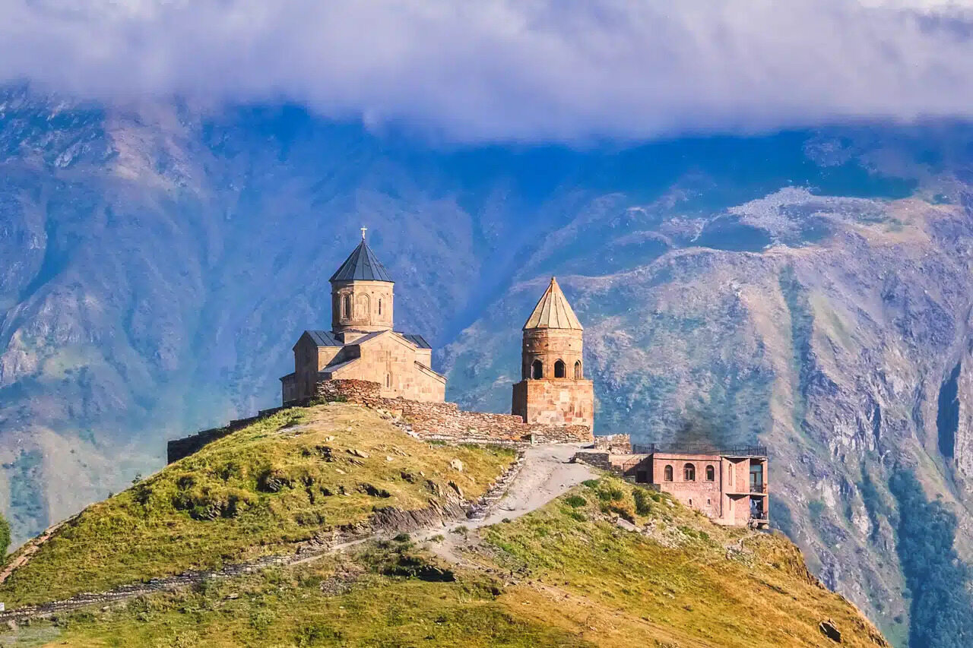
Methodology
In this section we will summarize the characteristics of the survey respondents. Including socio-economic background, age, gender, educational level and nationality.
Survey was available online from 5 March to 12 April (2015). In total 265 respondents start survey, however 122 respondents have never been in Kazbegi National Park, which led them to an impossibility of filling out the rest of questionnaire.
They were directly led to the last page of the survey the “thank you” page. 143 respondents were able to complete sample, which is 54% response rate

Slide 7
Results
In terms of respondent’s nationality, 96.4% are Georgian and only 3.6 % represents the foreigners from Armenia, Lithuania and Great Britain.
To the question “How many times have you been to Kazbegi National Park?” 25% have been 1 times, 17% - 2 times, 36% of respondents answer that they have been 3 times and more and 21% is not sure on how many times have visited the park.
Regarding the companions 57% of respondents mentioned that they are traveling with friends/ family members with more then 3 people, 15% travels with tourist groups, 7% is alone traveler and 4% is traveling with single companion.
In terms of future visitation we present the question “ what do you plan to do in future?” out of 83 respondent 55% are willing to visit more frequently, 25% are not sure about the future decision, 18% are ready to visit with the same amount and only 1% are about to visit less frequently.

Slide 8
Tourist were questioned, “How they describe the current level of tourism development in Kazbegi National Park?” As it was supposed, 49.40% of tourists wish to have more tourism development sites, and more encouragement to the sector.
The major hypotheses tasted in this paper concerned the significance of Sense of Place variables in terms of Kazbegi National Park, and correlations with internal variables. Therefore, discussion of the results is followed up to the hypothesis and important findings.
Based on the results these three factors have significance level in the given case. However, we cannot assume and generalize the finding, it may differ from place to place.
The result was not different then we expected, as acknowledged in literature ‘Sense of place’ is an umbrella concept and variables inside can have different understanding, therefore, different assumptions. However, it doesn’t except neither reject that variables might be correlated. Hence, Place attachment; Place identity and Place dependence are positively correlated in this study

Slide 9
Conclusions
According to [9], tourism is an important way for humans to perceive and understand the environment, as a relationship between itself and the place. In this sense, place attachment has attracted considerable attention within tourism, with critical importance to destination competitiveness and sustainability.
In response to limited research projects in literature and in practice connecting to sense of place in Kazbegi National Park, we have defined two major thesis aims. First of all, authors intend to take the advantage and fill the gap in the literature to examine Sense of Place towards to Kazbegi National Park.
Therefore, the given thesis is the pioneer in the field, which creates a good basement for future studies. As limitations, we refer to the possibility of including any other type of measuring instrument, such as, for example: combinations of verbal and pictorial techniques.

Slide 10
REFERENCES
[1] Kaltenborn, B. (1998). Effects of sense of place in responses to envitonmental impacts: a study among residents in Svalbard in the Norwegian High Arctic. Applied Geography , 18 (2), 169-189.
[2] Sousa, B., & Rocha, A. T. (2019). The role of attachment in public management and place marketing contexts: a case study applied to Vila de Montalegre (Portugal). International Journal of Public Sector Performance Management, 5(2), 189-205.
[3] Shamai, S., & Ilatov, Z. (2005). Measuring sense of place: Methodological aspects. Tijdschrift voor Economische en Sociale Geografie , 96, 467-476.
[4] Barker, J. E. (1979). Designing for a sense of place in Mississippi small towns. (W. P. Prenshaw, & J. O. Mckee, Eds.) Sense of place: Mississippi , 162-178.
[5] Jackson, J. B. (1995). A Sense of Place, A Sense of Time. 164 , 24-27.
[6] Relph, F. (1976). Place and Placelessness. London: Pion.
[7] Lewis, P. (1979). Defining sense of place. (W. P. Prenshaw, & J. O. Mckee, Eds.) Sense of Place: Mississippi , 24-26

Slide 11



