Slide 1
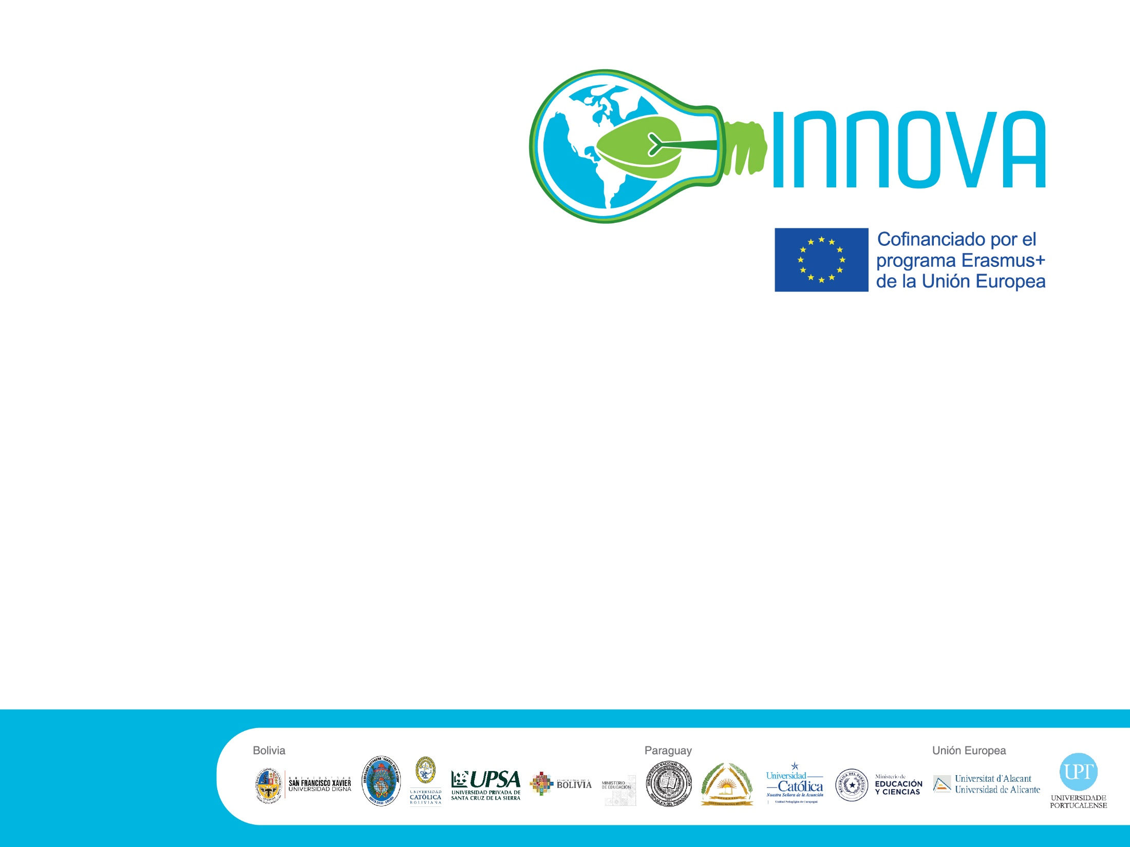

II Conferencia Nacional en Bolivia
6 y 7 junio 2023

Slide 2

Climate Change Research Networks:
Sustainability and Sport
Ricardo Cayolla, Ph.D.
Universidade Portucalense
rcayolla@upt.pt
6th of June 2023

Slide 3

Index
Research done
Case study
Stakeholders involved

Slide 4
What is the role of memory in consumer–brand relationship?
Insight from sport industry
Journal of Creative Communications, 2021
2021
Sustainable Initiatives in Sports Organizations:
Analysis of a Group of Stakeholders in Pandemic Times
Sustainability, 2021

Slide 5
Communicating the Value of Fan Identity in the Sport Industry: Commentary on Consumer Neuroscience Possible Research Ideas
International Journal of Sport Communication, 2022
“If You Don’t Know Me by Now”—
The Importance of Sustainability Initiative Awareness
for Stakeholders of Professional Sports Organizations
Sustainability, 2022
2022
The rooted fan: Exploring suggested improvements
to a professional sport team's sustainability initiatives
37th Annual North America Society Sport Management Conference, 2022

Slide 6
Environmental Sustainability and Sports Management:
A Review of Marketing Contributions and Discussion
of Future Research Opportunities
Smart Innovation, Systems and Technologies, 2023
Analysis of Travel Behaviour of Professional Sports Organisation Members to the Stadium: Future implications for Sustainability
Sustainability, 2023
Brand Love vs. Fan Identity (ESIS). Pro-Environmental Benefits of Being Deeply in Love with the Club: How Brand Love Foster Fans’ Sustainable Behaviours
European Association for Sport Management, 2023
2023
Neural correlates of sport fans. The role of fan identification and team brand strength
Sport Marketing Association 2023
Does sustainable attitudes predict sustainable behaviors: Examining the attitude-behavior gap in sport fans and university students
38th Annual North America Society Sport Management Conference, 2023
Fans’ Perceptions of Pro-Environmental Sustainability Initiatives in Sport and Triple Bottom Line Benefits
International Journal of Sports Marketing and Sponsorship, 2023

Slide 7
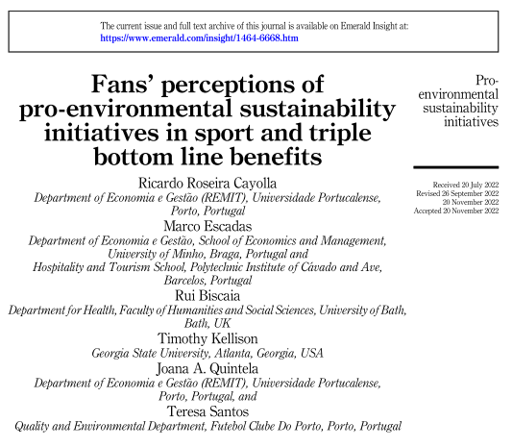

Slide 8
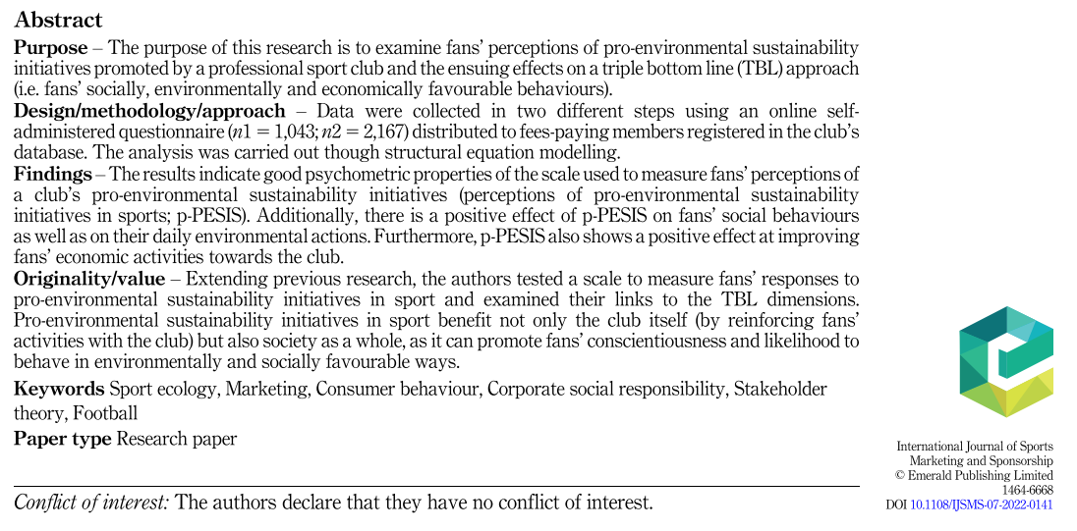

Slide 9
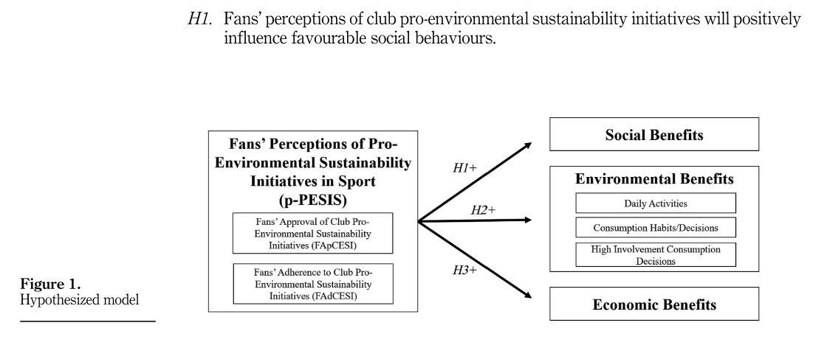

Slide 10
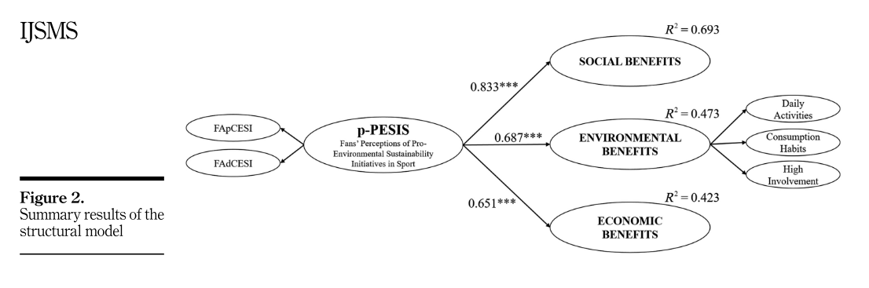

Slide 11
Stakeholders
Rui Biscaia, Department for Health, Faculty of Humanities and Social Sciences, University of Bath, UK
Marco Escadas, School of Economics and Management, University of Minho, Braga, Portugal
Hang-Yee Chan, Kings College, Department of Marketing, UK
Aaron Ahuvia, Department of Management Studies, University of Michigan-Dearborn, USA
Timothy Kellison, Georgia State University, Atlanta, Georgia, USA
Brian P. McCullough, Texas AM, USA
Marc Fetscherin, Rollins College, Department of Business, Winter Park, USA
Roy Baumeister, School of Psychology, The University of Queensland, Australia
Catarina Duarte, Institute of Nuclear Sciences Applied to Health, Universidade de Coimbra, Portugal
Miguel Castelo-Branco, Institute of Nuclear Sciences Applied to Health, Universidade de Coimbra, Portugal
Joana A. Quintela, Department of Economia e Gestão (REMIT), Universidade Portucalense, Porto, Portugal
Teresa Santos, Quality and Environmental Department, Futebol Clube do Porto, Porto, Portugal

Slide 12


