Slide 1

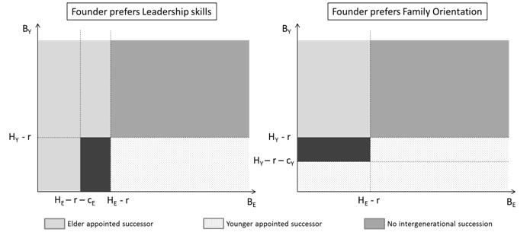
Successor Selection in Family Firms - Advantage of being first
Shital Jayantilal, Sílvia Ferreira Jorge, Tomás M. Bañegil Palacios
University of Extremadura
Introduction
The uniqueness of all family firms reside, in what Habbershon & Williams (1999) referred to as familiness, resulting from the interconnection and overlap between the family and the firm. This permeability of the firm means that decisions made in the family firm are affected by both the business and the family. Family firms, given the overlap of the business and the family dimension, are prone to be a fertile ground for conflict and tension. This has triggered research on conflict in family firms and its impact on the firm’s growth and continuity however little attention has been paid to the specific conflict resulting from sibling rivalry in the succession race.
Objective
We respond to this by putting this type of conflict, which has plagued many Asian family firms, at the centre stage. We focus on studying whether there is any advantage for the sibling who places him/herself first in the succession race. In other words, we want to analyse if there is any first mover advantage. The first mover advantage (FMA) is the advantage that the initial (first-mover player) gets from being the first to play
Results
Variables
Leadership Skills (L_{i}>0, i=[E,Y]), encompassing all competencies, know-how and skills considered important ; Family Orientation (O_{i}>0) is the extent the child perceives and values the family’s involvement in the family firm ; the founder’s preference for the business dimension, given by α (α>0) and the family dimension, given by (β>0). The emotional cost of conflict is represented by c_{j} (c_{j} >0, j=[E,Y,F]). The value attributed to heading the family firm H_{i} (H_{i} >0) net of the cost of running for the position, given by r, (r >0), assuming (H_{i} >r).
Fig 1. Game tree representation with elder being the first mover
Discussion and conclusion
In the original game, the elder child moves first and the extent to which the younger child prefers to avoid conflict is directly linked to the elder child’s propensity of being appointed successor. Altering the sequence and starting with the younger child as the first mover, enables to analyse the possible FMA.
It is evident that the emotional cost of conflict which occurs when both children run for the successor position is more relevant, in terms of succession outcome, for the child who moves in second.
The emotional factors justify the first mover advantage. The cost of conflict is of fundamental importance. The higher the cost of conflict of the child who moves in second place, the larger the advantage the child who moves first has in being appointed successor.
The existence of the first mover advantage means that from the children’s perspective, the more reluctant a child is to conflict the greater will be the benefit for his sibling to move first. From the founder’s perspective, he prefers that his desired successor be the first mover. Consequently, the founder has an added impetus to motivate his preferred successor to take the initiative and be the first to run for the top position in the family firm.
Methodology
Following the Jayantilal, Jorge & Palacios. (2016) theoretical framework, the modeled game has three players: the father and founder of the family firm (F), his elder child (E) and his younger child (Y). The game starts by the elder child deciding whether to run for the CEO position in the family firm or instead pursue a career elsewhere, this is then followed by younger child’s decision as to what to do and finally the founder selects his successor. (Figure 1)
To analyze whether there is indeed any advantage for the first mover it is necessary to remodel our game changing the order of play and then comparing the results. (Figure 2)
Fig 2. First Mover Advantage – Compares sucessor oucomes for hen E moves first with those from when Y moves first
Notes:
Referencias bibliográficas:
Antoncic, B. & Hisrich R.D: (2004): “Corporate entrepreneurship contingencies and organizational wealth creation”. The Journal of Management Development, 23(5-6): 518-550.
Astrachan, J.H. & Jaskiewicz, P. (2008): “Emotional Returns and Emotional Costs in Privately Held Family Business: Advancing Traditional Business Valuation”. Family Business Review, XXI (2): 139-149.
Baden - Fuller, C. (1995): “Strategic innovation, corporate entrepreneurship and matching outside- in to inside-out approaches to strategy research”. British Journal of Management, 6, S3-S16.
Corona, J. (2006): Manual de la Empresa Familiar. Ediciones Deusto: Barcelona.
Durán, P.; Kammerlander, N; van Essen, M. & Zellweger, T. (2016): “Doing more with less: innovation input and output in family firms”. Academy of Management Journal, 59 (4): 1224-1264.
Gómez-Mejía, L.R. Cruz, C.; Berrone, P. & De Castro, J. (2011): “The bind that ties: Socioemotional Wealth Preservation in Family Firms”. The Academy of Management Annals, 5 (1): 653-707.
Kuratko, D.F. (2009): “The entrepreneurial imperative of the 21st century”. Business Horizons, 52(5): 421-428.
Sharma, P. & Manikutty, S. (2005): “Strategic Divestments in Family Firms: Role of Family Structure and Community Culture”. Entrepreneurship Theory and Practice, 29 (3): 293-311.

