Slide 1

The Neurological Aspects of Brand L ve
Ricardo Cayolla¹, Marc Fetscherin², Sónia Costa^{3,4}, I. Catarina Duarte⁴, Miguel Castelo-Branco⁴
1 – University of Aveiro
2 – Rollins College
3 – CNBC – Centre of Neurosciences and Cell Biology UNIT
4 – Institute of Nuclear Sciences Applied to Health (ICNAS) - University of Coimbra, Portugal
Special thanks to José Paulo Santos – ISMAI
4th Consumer Neuroscience Symposium | University of Miami | 24. September 2015

Slide 2
Research Team
Ricardo Cayolla
Department of Business
University of Aveiro, Portugal
Marc Fetscherin
Department of Business
Rollins College, USA
Sónia Costa
Centre of Neurosciences
& Cell Biology UNIT
University of Coimbra, Portugal
Catarina Duarte
Institute of Nuclear Sciences Applied to Health (ICNAS), University of Coimbra, Portugal
Miguel Castelo-Branco
Institute of Nuclear Sciences Applied to Health (ICNAS), University of Coimbra, Portugal

Slide 3
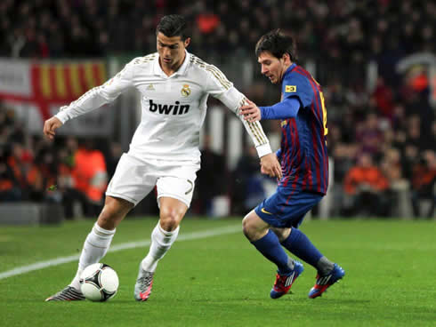
Football (soccer)

Slide 4
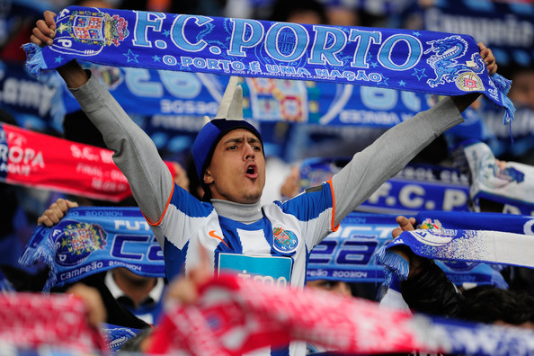
Origins

Slide 5
Key Statistics
60
13
>200
>180
TOTAL # SUBJECTS
THIS STUDY
QUESTIONS / SURVEY
MINUTES / PER PERSON

Slide 6
Research Design
VIDEO
Attachment
PRISONER DILEMMA
Sacrifice
QUESTIONNAIRE
FMRI
Demographical Questions
Personality Test – Big Five Inventory
Football fan’s Identification Scale
Football Supporters Fanatics Scale
Galvanic Conduct
ECG
BATTLE OF SEXES
Decision

Slide 7
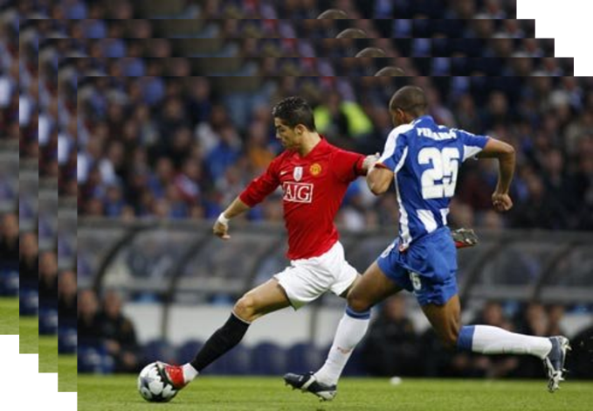
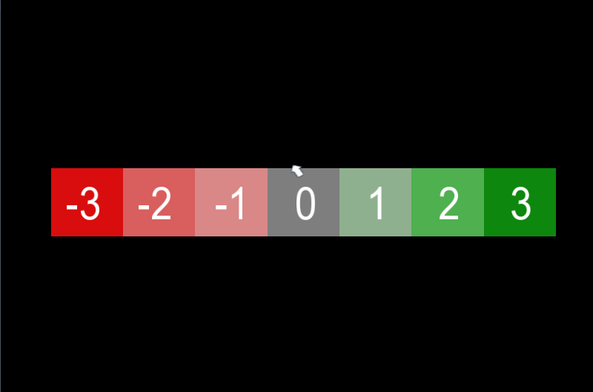

Video
video
6 - 12 s
response
8 s
fixation
9 - 15 s
Notes:
Does neuronal correlates of positive and negative thoughts about a football brand?
No período de fixação, pedimos que o voluntário não pense em nada. A ideia é que a resposta hemodinâmica (fluxo de sangue e aporte de oxigénio volte aos níveis basais). o facto de variar é para facilitar o processamento em fMRI (não é importante que detalhe).

Slide 8
Positive situation of the favorite team
Negative situation of the favorite team
Positive situation of the least favorite team
Negative situation of the least favorite team
Control condition: situation in another sport

Slide 9
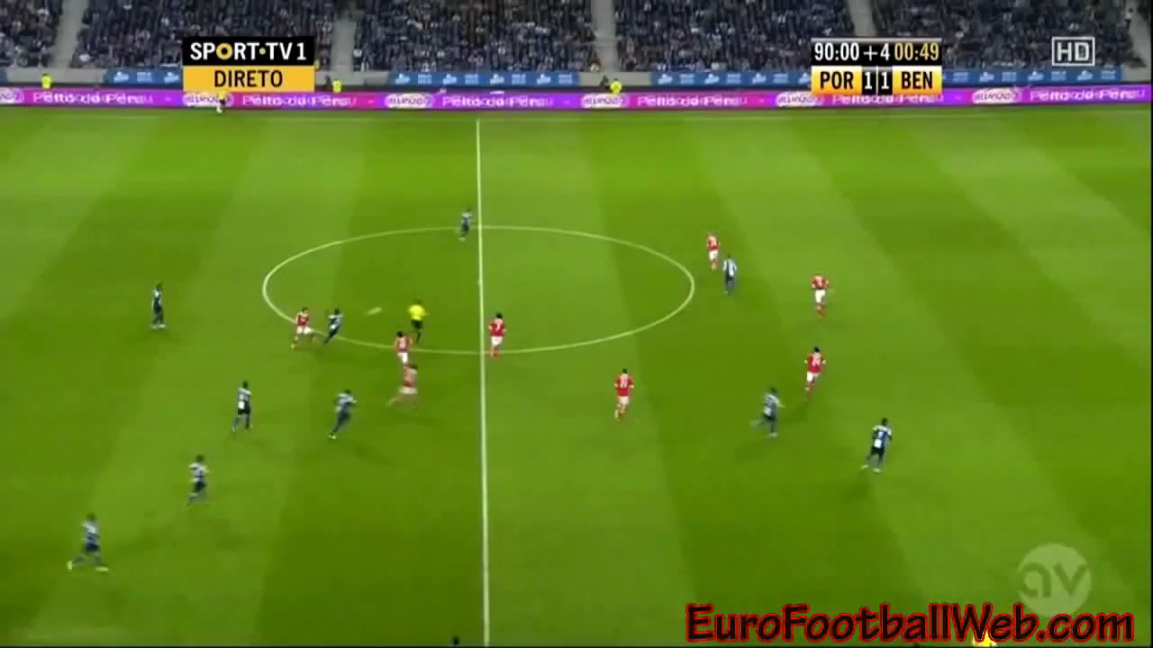
Notes:
Does neuronal correlates of positive and negative thoughts about a football brand?
No período de fixação, pedimos que o voluntário não pense em nada. A ideia é que a resposta hemodinâmica (fluxo de sangue e aporte de oxigénio volte aos níveis basais). o facto de variar é para facilitar o processamento em fMRI (não é importante que detalhe).

Slide 10
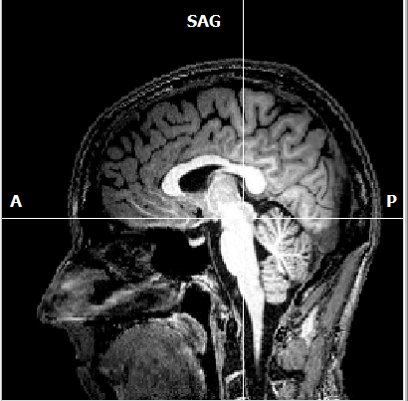
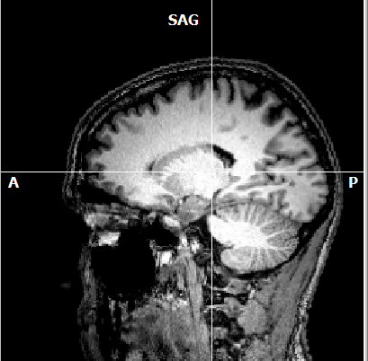
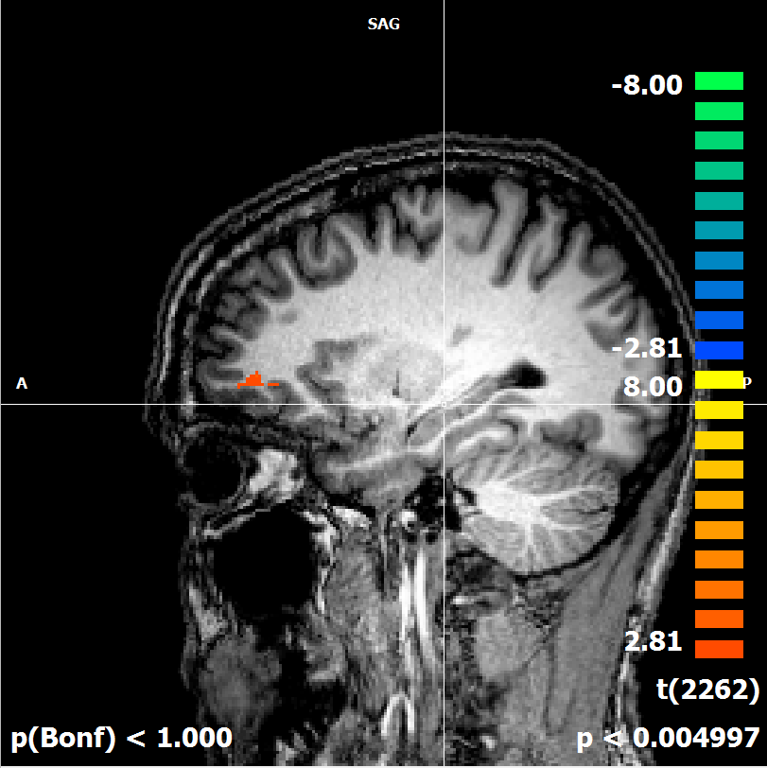
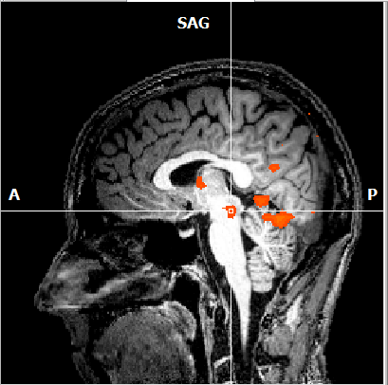
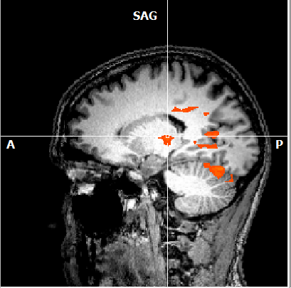
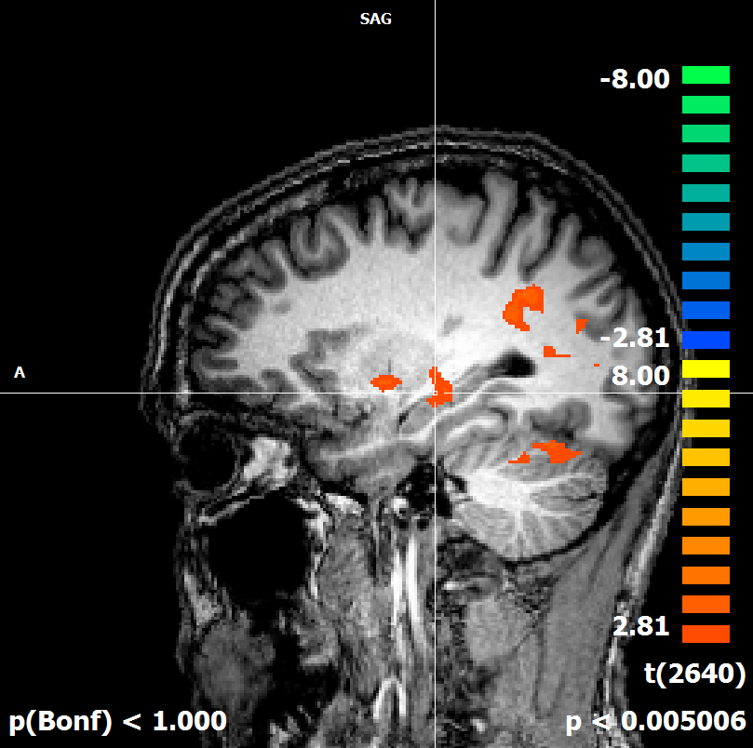
fMRI - Fan
fMRI – Fan-atic

Slide 11
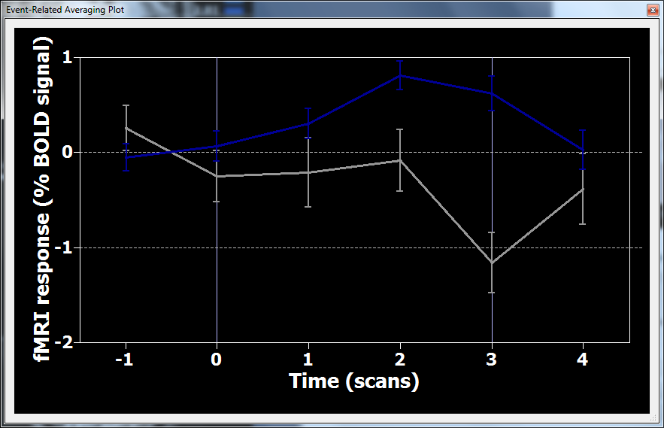
Ventral Tegmental Area
Ventral Tegmental Area (the origiyn of the dopaminergic system)

Slide 12
Conclusions:
Personality does matter in respect to the commitment (fanaticism)
consumers have towards a brand.
Our experiment suggests that fanatics (DF) have
activations in certain parts of the brain when exposed to brand.
We also find that casual fans (CF) don’t have activations.
Future research is needed to further assess this.
Preliminary Conclusions
Does matter in respect to commitment (fanaticism)
Fanatics vs. non fanatics

Slide 13
Thank y u
Ricardo Cayolla¹, Marc Fetscherin², Sónia Costa^{3,4}, I. Catarina Duarte⁴, Miguel Castelo-Branco⁴
1 – University of Aveiro
2 – Rollins College
3 – CNBC – Centre of Neurosciences and Cell Biology UNIT
4 – Institute of Nuclear Sciences Applied to Health (ICNAS) - University of Coimbra, Portugal
Special thanks to José Paulo Santos (ISMAI)
4th Consumer Neuroscience Symposium | University of Miami | 24. September 2015

