Slide 1
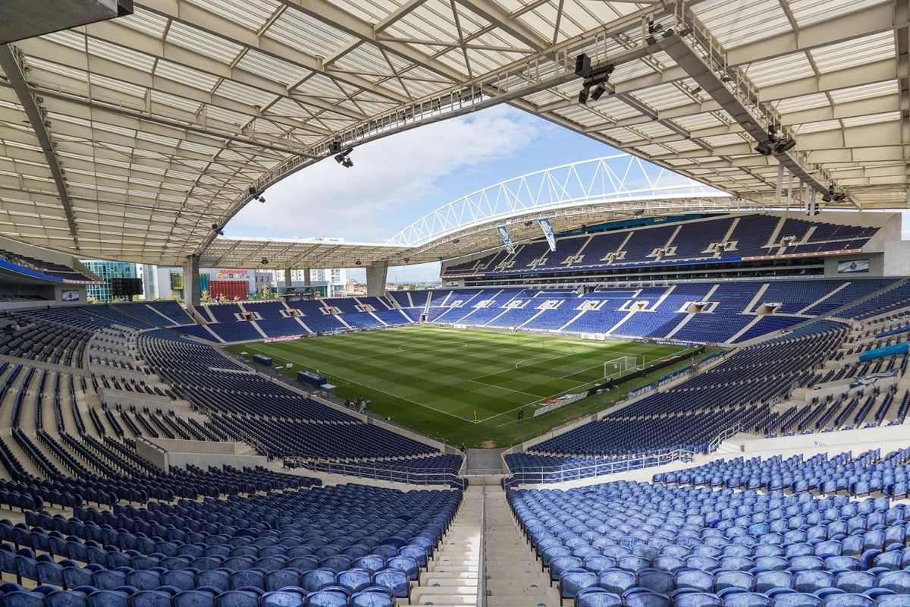
O FCPorto e a Sustentabilidade: estado da arte.
Estádio do Dragão, 7 de Março 2023

Slide 2
FCPorto líder da Sustentabilidade

Slide 3
E os outros?

Slide 4
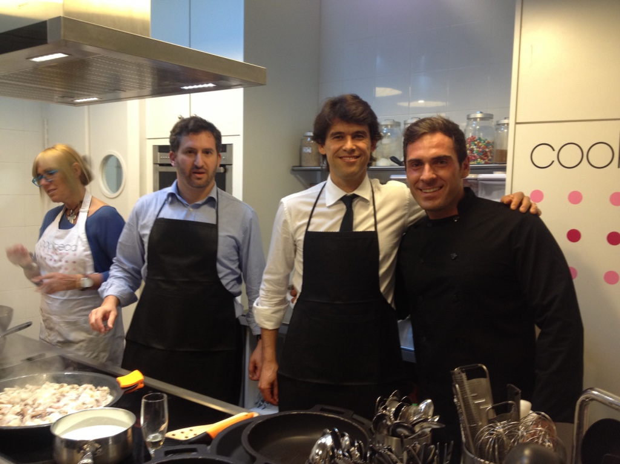

Slide 5
Especial agradecimento
ao Dr. Afonso Gama
e à Dra. Teresa Santos pela confiança demonstrada
e possibilidade de realizar todos estes trabalhos
desde janeiro de 2021.

Slide 6
Estudos efetuados

Slide 7
Trabalhos publicados: quatro (4)
Cayolla, R., Escadas, M., Biscaia, R., Kellison, T. B., Quintela, J. A., & Santos, T. (2023). Fans ’ perceptions of pro-environmental sustainability initiatives in sport and triple bottom line benefits initiatives. International Journal of Sports Marketing & Sponsorship.
Cayolla, R., Quintela, J. A., & Santos, T. (2022). “If You Don’t Know Me by Now”— The Importance of Sustainability Initiative Awareness for Stakeholders of Professional Sports Organizations. Sustainability, 14, 1–16.
Cayolla, R., Kellison, T. B., Mccullough, B. P., Biscaia, R., Escadas, M., & Santos, T. (2022). The rooted fan: Exploring suggested improvements to a professional sport team’s sustainability initiatives. In 37th Annual NASSM Conference (p. 31). Atlanta, GA.
Cayolla, R., Santos, T., & Quintela, J. A. (2021). Sustainable Initiatives in Sports Organizations—Analysis of a Group of Stakeholders in Pandemic Times. Sustainability, 13(16), 9122.

Slide 8
Trabalhos submetidos, aceites, por publicar: três (3)
Cayolla, R., Kellison, T. B., McCullough, B. P., Biscaia, R., Escadas, M., Santos, T. (2023). Does sustainable attitudes predict sustainable behaviors: Examining the attitude-behavior gap in sport fans and university students. NASSM.
Cayolla, R. (2023). A Relação entre o Adepto e o Clube. In A. Correia, R. Biscaia, & T. Ribeiro (Eds.), Lições de Gestão do Desporto. Lisboa: Associação Portuguesa de Gestão do Desporto (APOGESD).
Cayolla, R., & Escadas, M. (2023). Environmental Sustainability and Sports Management: A Review of Marketing Contributions and Discussion of Future Research Opportunities. Smart Innovation, Systems and Technologies.

Slide 9
Trabalhos submetidos, a aguardar decisão: três (3)
Cayolla, R., Escadas, M., McCullough, B. P., Biscaia, R., Cabilhas, G., Santos, T. (2023). Does pro-environmental attitude predict pro-environmental behavior: Comparing sustainability connection in emotional and cognitive environments. International Journal of Sustainability in Higher Education
Cayolla, R., Kellison, T. B., McCullough, B. P., Biscaia, R., Escadas, M., Santos, T. (2023). Exploring the Evolution of Fan Expectations to a Professional Sport Team’s Environmental Sustainability Initiatives During the COVID-19 Pandemic. Journal of Leisure Research
Cayolla, R., Quintela, J. A., & Santos, T. (2023). No matter where you live, I know how you get to the stadium – future implications for sustainability. Sustainability

Slide 10
Trabalhos em escrita: dois (2)
Cayolla, R., Escadas, M., Biscaia, R., Ahuvia, A., Kellison, T. B., & Santos, T. (2023). Brand Love vs. Fan Identity: The role of Sustainability.
Cayolla, R., Escadas, M., & Santos, T. (2023). The profile of a season ticket holder.

Slide 11
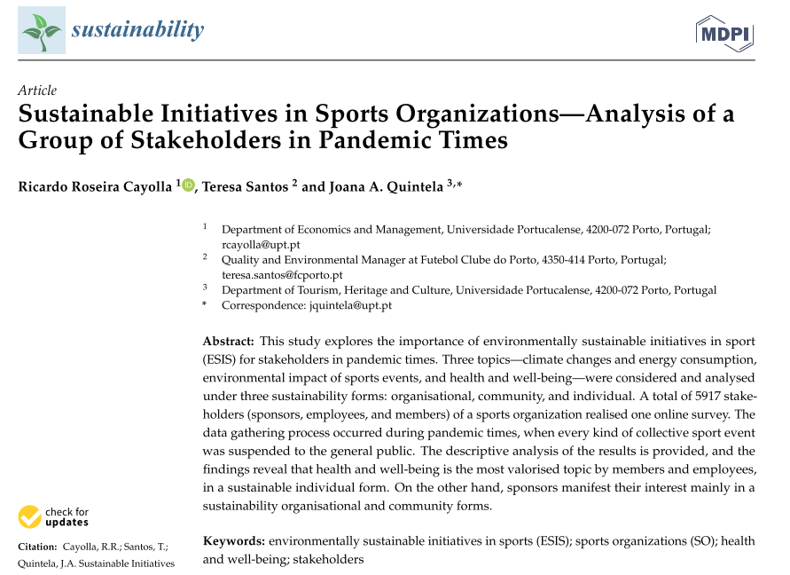

Slide 12
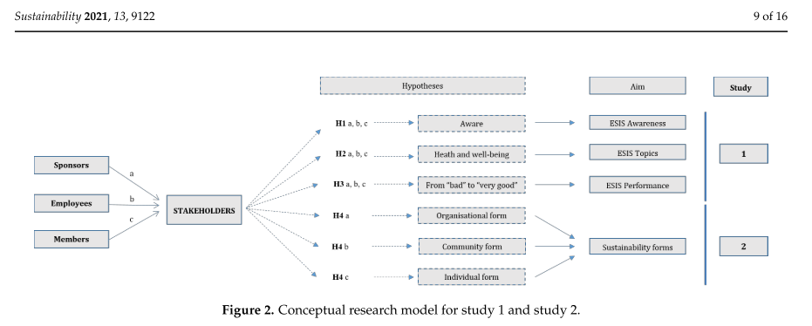

Slide 13
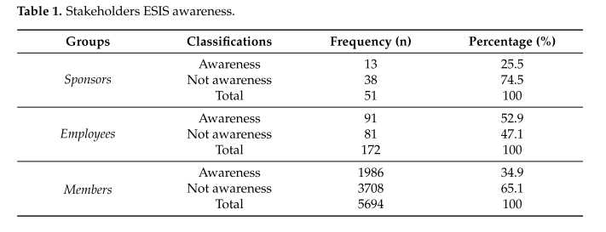

Slide 14
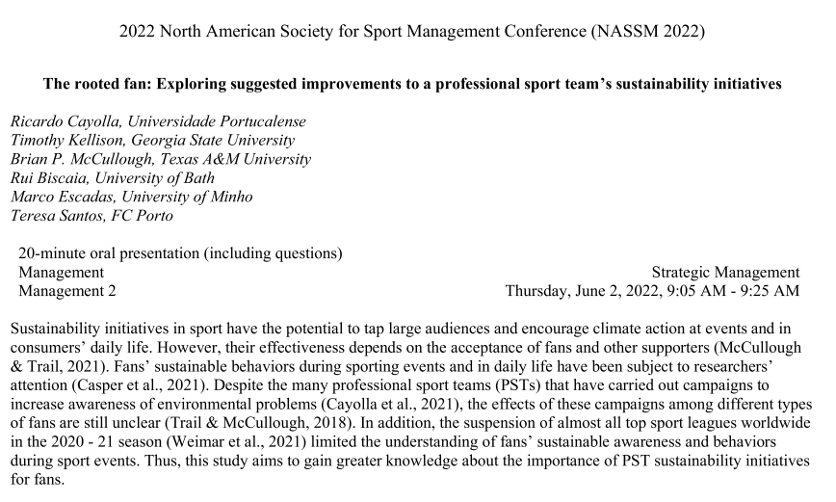

Slide 15
﻿The current results suggest PSTs should consider three key ideas when developing sustainability initiatives.
First, it is crucial to obtain knowledge of what sustainable initiatives their fans consider to be more important.
Second, PSTs must monitor how these initiatives evolve over time (e.g., by measuring how fans classify the consistency of waste reduction initiatives in the stadium, how they experience the measures implemented by the PST, and how aware they are of all initiatives).
Third, PSTs could use the levels of awareness and sustainable behaviors adopted by fans to develop a segmentation strategy and better customize their communication and impact of sustainability initiatives.

Slide 16
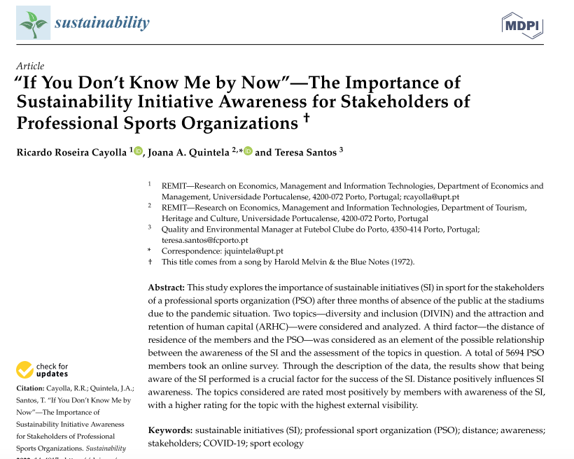

Slide 17
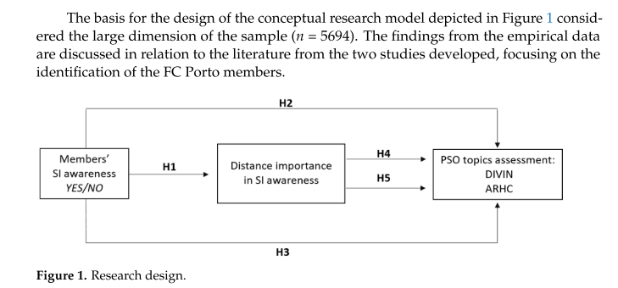

Slide 18
This is the first study in which it is confirmed that distance has no impact on the awareness that members have about PSO SIs.
﻿The second contribution to the literature is the positive importance of distance for members who have PSO SI awareness because distance strengthens the members’ relationship with the PSO.
The third contribution to the literature is member awareness of the SI implanted to evaluate the topics more positively, thus reinforcing the importance of member SI awareness.
﻿The fourth contribution reinforces the importance of members’ SI awareness and the (ir)relevance that distance has in the topic assessment.

Slide 19
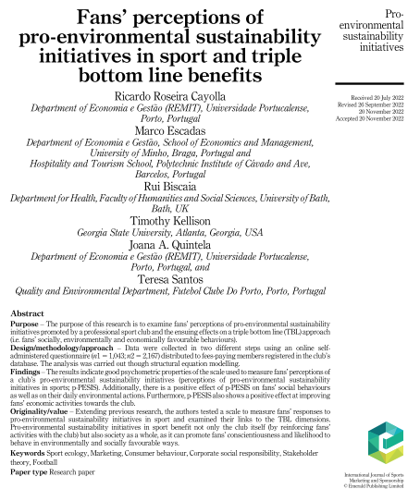

Slide 20
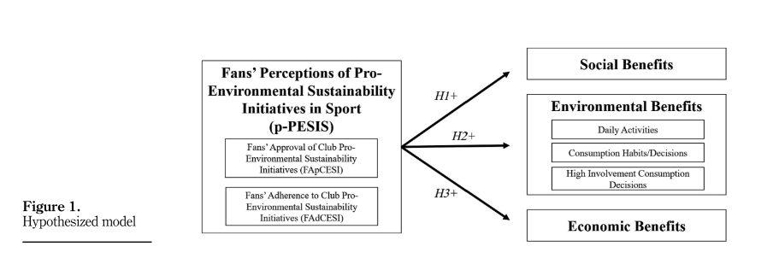

Slide 21
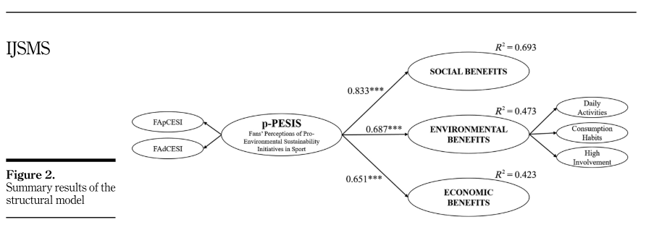
﻿This research is one of the first contributions exploring fan perceptions as an essential element in assessing clubs’ pro-environmental initiatives and delivers the recommended attention to a key sport stakeholder that can actually drive and encourage environmental change: the fans.
﻿Fans that approve and that intend to adhere to club pro-environmental initiatives
are more mindful of environmental issues and more likely to adopt environmentally favorable behaviors in both personal and social settings and
2) intend to develop a stronger economic relationship with the club.

Slide 22
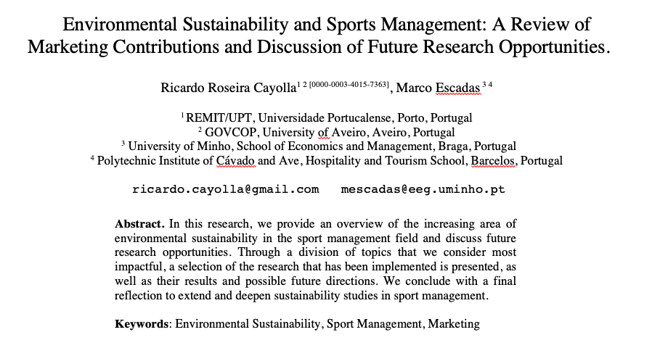

Slide 23
Far more is known today than just two decades ago in environmental sustainability. In sports, progress has been made very quickly in this specific area of sustainability.
However, the truth is that we are still in the first steps toward a more sustainable sports industry from an environmental perspective.
For sports organizations, simple actions such as making annual reports, monitoring, controlling, and evaluating the initiatives carried out are crucial for better sustainable performance in all its perspectives: environmental, economic, and social.
Further, standard vocabulary (e.g., ES, ESIS, SI) is also desirable for faster and deeper dissemination and understanding of the research executed.

Slide 24
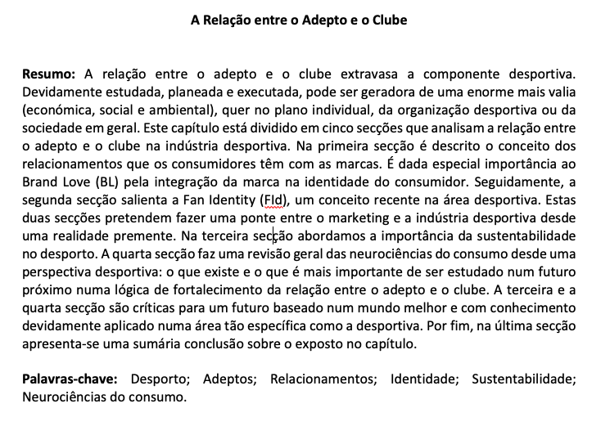

Slide 25
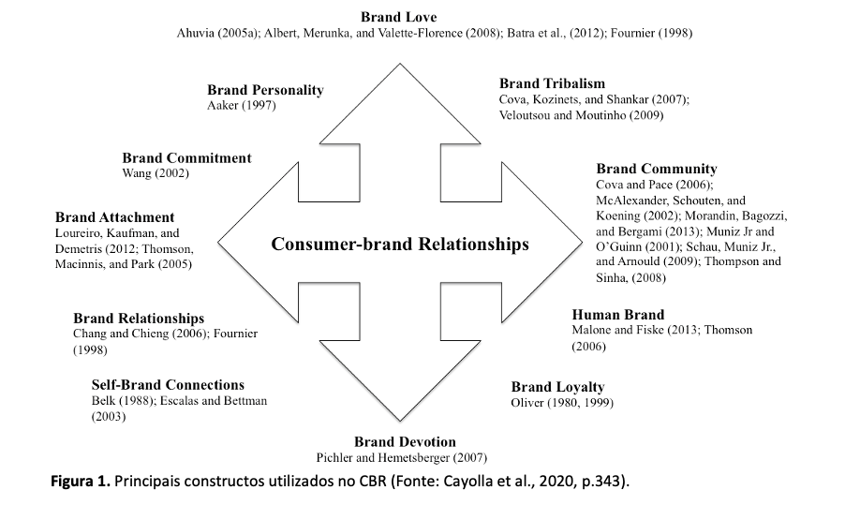

Slide 26
O desporto difere de outras fontes de entretenimento por evocar altos níveis de apego emocional e identificação (Sutton et al., 1997). As práticas sustentáveis no setor de desporto têm o potencial de promover o compromisso público com a proteção ambiental. Numa sociedade global cada vez mais consciente da degradação ecológica causada pelas empresas, o desporto sustentável pode oferecer à sociedade uma plataforma para um futuro mais ‘limpo’ (Trendafilova et al., 2014). Através dos programas sustentáveis, as organizações de desporto podem melhorar a experiência do consumidor e fortalecer os laços com a comunidade (Blankenbuehler & Kunz, 2014).
Praticada de forma sistemática e contínua, a sustentabilidade pode beneficiar as organizações de desporto de quatro maneiras:
fortalecendo os laços entre as comunidades,
aumentando a base de adeptos,
tornando as operações menos onerosas financeiramente e, por fim,
beneficiando a sociedade globalmente (Trendafilova et al., 2013).
Posto isto, qual é “o problema” da sustentabilidade no setor de desporto?

Slide 27
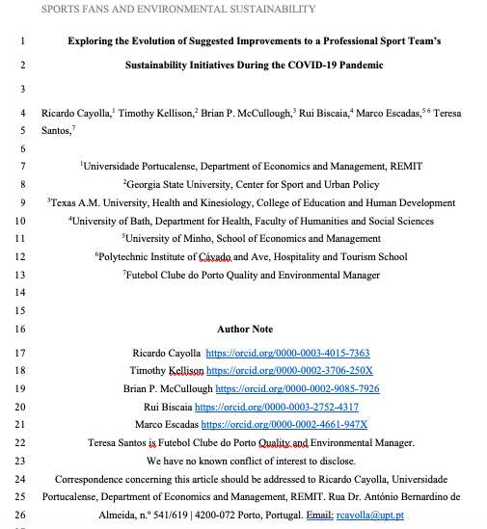

Slide 28
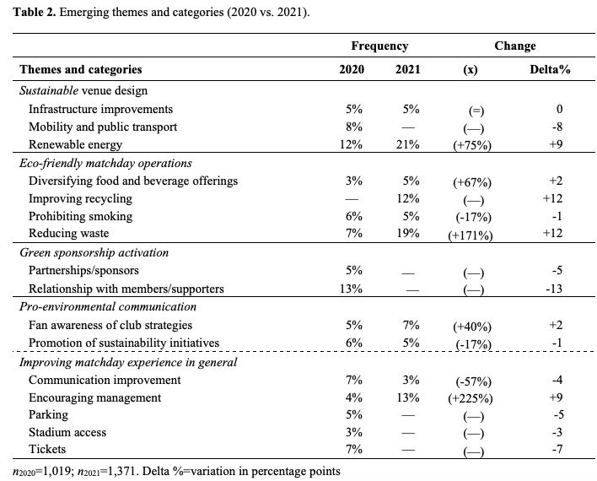

Slide 29
In this study, we examined fan responses to professional football clubs’ environmental sustainability initiatives, particularly to the extent to which fan expectations changed during the COVID-19 pandemic.
The results indicate that the members' suggestions are directed toward greater awareness of the importance of sustainability initiatives, both in events and daily life.
First, it provides an overview of what fans think about the importance of environmental sustainability initiatives. This knowledge is essential for the strategic plan for PST’s future sustainable programs. It highlights how crucial it is to know what sustainable initiatives fans consider more important (Cayolla et al., 2021). Regardless of the pandemic period, three categories stood out for their consistency: infrastructure improvements, prohibiting smoking, and promoting sustainability initiatives. This information safely guides PST's actions in the area of sustainability.
Second, PSTs must monitor how these initiatives evolve. Sport managers reacted quickly to the new reality caused by COVID-19, with drastic changes in the habits and behavior of stakeholders (Smith & Skinner, 2021). In the 2021 questionnaire suggestions, there was a greater concentration of categories with a particular focus on sustainable behaviors (renewable energy, reducing waste, improving recycling) that are essential in building a “resource-circulating society” (Komiyama & Takeuchi, 2006, p. 3).
Third, PSTs could use the levels of awareness and sustainable behaviors adopted by fans to better customize their communication and impact of sustainability initiatives (Guerrero Medina et al., 2020; Trail & McCullough, 2018) and must continue to create conditions to promote sustainable attitudes and behaviors by all stakeholders.

Slide 30
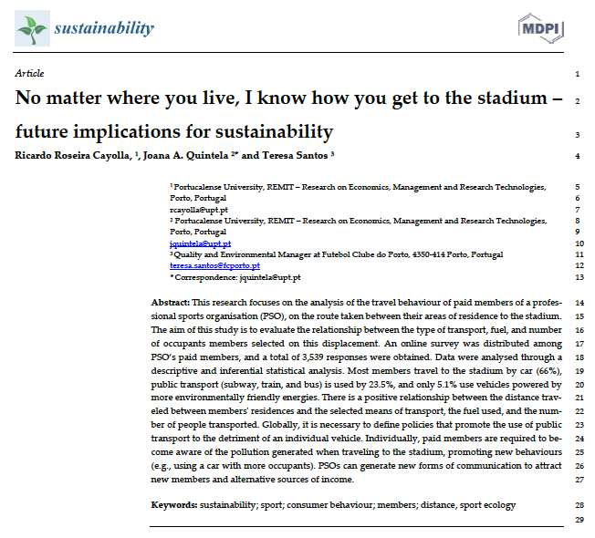

Slide 31
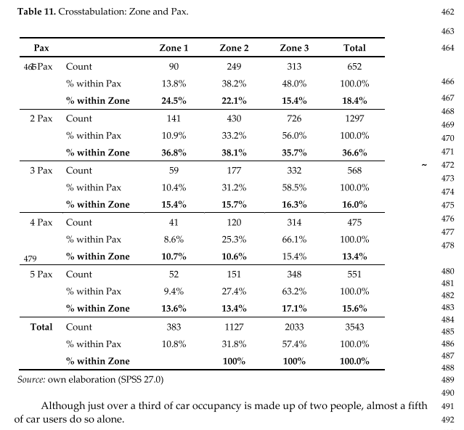

Slide 32
﻿First, it provides information on how members, the main stakeholders of a PSO, usually travel to home games. It is essential knowledge for sustainability initiatives' success, including designing strategies to attract more members (e.g., 90% of members who travel on foot are from Zone 1).
Second, by addressing fuel, it allows for a doubly positive approach. Globally, for society, by making a diagnosis in favor of future mobility policies by the authorities. Specifically, for PSOs’, generating added value in future revenues unconventionally 530 (e.g., electrical charging).
Third, relating transport, fuel, and the number of occupants in the car provides insight into how a specific type of consumer behaves. The greater the distance from the stadium, the more dependence on car use increases exponentially. It should alert political authorities in the design of mobility strategies, even if only for event days.
Finally, given the high numbers of individual car occupancy (around 48% from the most remote area, Zone 3) and low levels of public transport use, the promotion of measures to support public transport or a more significant number of occupants per individual transport is mandatory from the sustainability point of view.

Slide 33
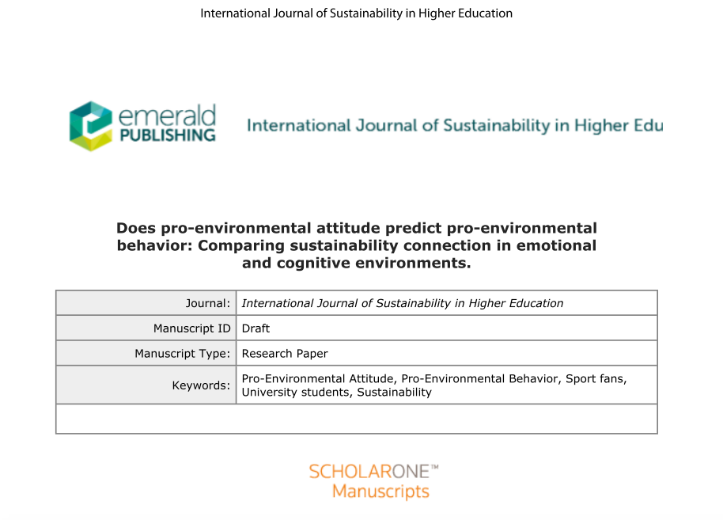

Slide 34
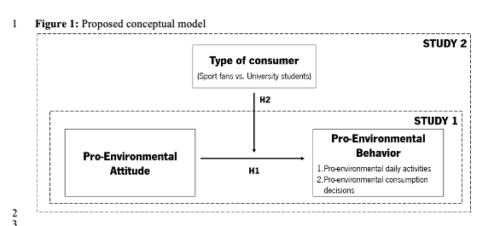

Slide 35
Through two studies, the results show that pro-environmental attitude positively influences behavior. Measures that encourage a favorable attitude towards the environment are desirable because they encourage environmentally friendly behaviors.
The results suggest that individuals with a greater emotional connection have higher average levels of pro-environmental attitude and pro-environmental behavior, meaning that this public assimilates in an effective way the messages and actions conveyed by clubs and organizations that promote environmental sustainability initiatives. So, pro-environmental initiatives promoted by sport organizations are desired and should be encouraged since they seem to influence fans’ environmentally favorable behaviors.
On the other hand, the magnitude of the influence between pro-environmental attitude and pro-environmental behavior is more significant in the group of individuals characterized by having a greater cognitive and intrinsic connection with the environmental cause - i.e., university students.

Slide 36
Principais conclusões

Slide 37
Estratégia
How members, the main stakeholders of a PSO, usually travel to home games. It is essential knowledge for sustainability initiatives' success, including designing strategies to attract more members (e.g., 90% of members who travel on foot are from Zone 1).
Relating transport, fuel, and the number of occupants in the car provides insight into how a specific type of consumer behaves. It should alert political authorities in the design of mobility strategies, even if only for event days.
The promotion of measures to support public transport or a more significant number of occupants per individual transport is mandatory from the sustainability point of view.

Slide 38
Objetivos
It's mandatory to have strategies, clear objectives, measures of success, or specific summaries of what was intended to be achieved.
It is crucial to obtain knowledge of what sustainable initiatives their fans consider to be more important.
PSTs must monitor how these initiatives evolve over time (e.g., by measuring how fans classify the consistency of waste reduction initiatives in the stadium, how they experience the measures implemented by the PST, and how aware they are of all initiatives).

Slide 39
Comunicação
Sports institutions are credible in passing on messages related to environmentally sustainable behavior.
The level of awareness of SI is very low (1/3 of the respondents), and even lower in sponsors.
Different stakeholder groups have different strategies depending on how ESIS topics are approached.
It is necessary the development of strategies and campaigns specifically aimed at different stakeholders.

Slide 40
Digital
Distance has no impact on the awareness that members have about PSO SIs.
In members who have PSO SI awareness distance strengthens the members’ relationship with the PSO.
Member awareness of the SI implanted to evaluate the topics more positively, thus reinforcing the importance of member SI awareness.

Slide 41
Economia
Fans that approve and that intend to adhere to club pro-environmental initiatives:
are more mindful of environmental issues and more likely to adopt environmentally favorable behaviors in both personal and social settings and
2) intend to develop a stronger economic relationship with the club.
Individuals with a greater emotional connection have higher average levels of pro-environmental attitude and pro-environmental behavior.
The magnitude of the influence between pro-environmental attitude and pro-environmental behavior is more significant in the group of individuals characterized by having a greater cognitive and intrinsic connection with the environmental cause - i.e., university students.

Slide 42
Resumindo
Praticada de forma sistemática e contínua, a sustentabilidade pode beneficiar as organizações de desporto de quatro maneiras:
fortalecendo os laços entre as comunidades,
aumentando a base de adeptos,
tornando as operações menos onerosas financeiramente e, por fim,
beneficiando a sociedade globalmente.
What fans think about the importance of environmental sustainability initiatives is important and is essential for the strategic plan for PST’s future sustainable programs.

Slide 43

Muito obrigado pela V. atenção.

